Slide 1
NFL 2017 Seasonal Analysis

Slide 2
2017 Season Overview
There were no anomalies in season structure.
32 teams split into 8 divisions, each comprised of 4 teams:
AFC East | AFC North | AFC South | AFC West | NFC East | NFC North | NFC South | NFC West
Buffalo Bills | Baltimore Ravens | Houston Texans | Denver Broncos | Dallas Cowboys | Chicago Bears | Atlanta Falcons | Arizona Cardinals
Miami Dolphins | Cincinnati Bengals | Indianapolis Colts | Kansas City Chiefs | New York Giants | Detroit Lions | Carolina Panthers | Los Angeles Rams
New England Patriots | Cleveland Browns | Jacksonville Jaguars | Los Angeles Chargers | Philadelphia Eagles | Green Bay Packers | New Orleans Saints | San Francisco 49ers
New York Jets | Pittsburgh Steelers | Tennessee Titans | Las Vegas Raiders | Washington Commanders | Minnesota Vikings | Tampa Bay Buccaneers | Seattle Seahawks

Slide 3

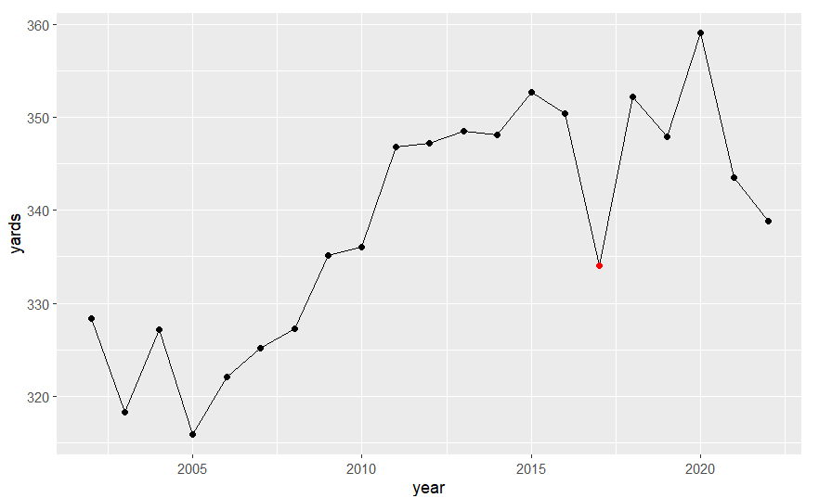
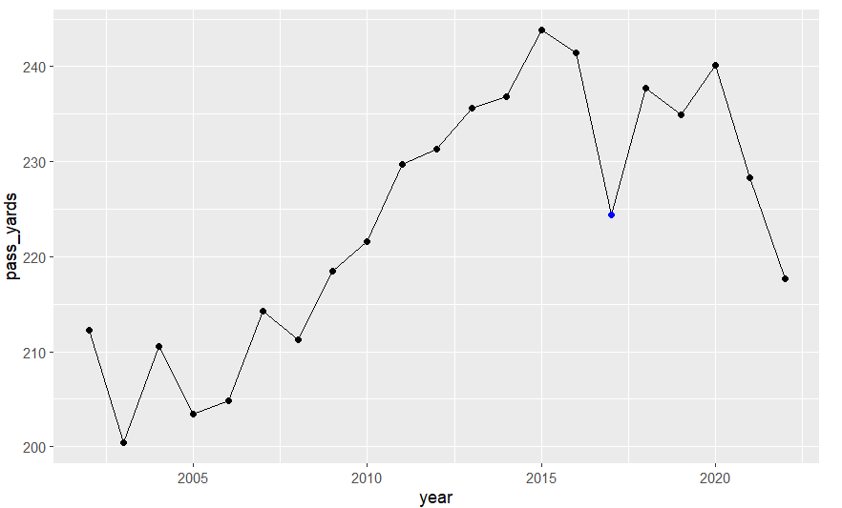
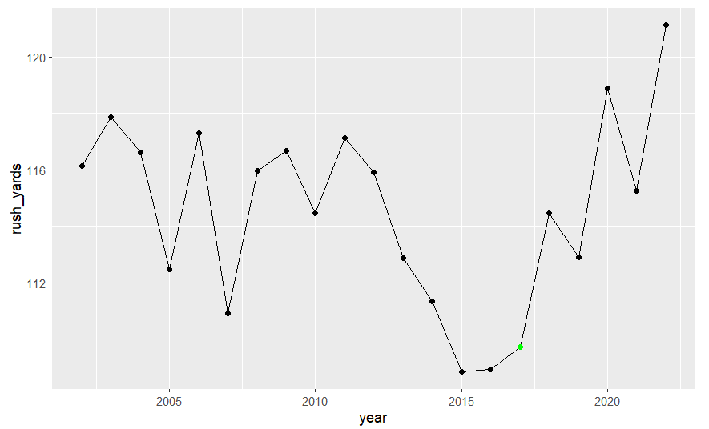
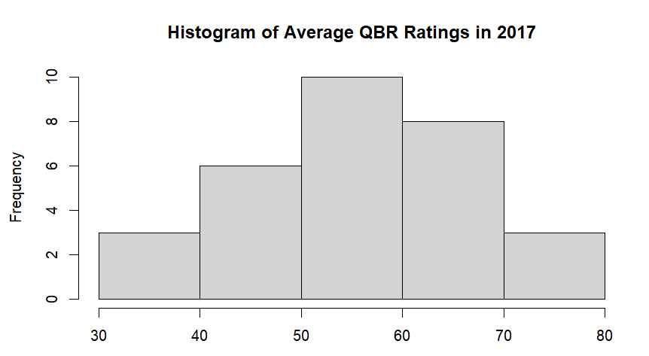
Relevant Statistics
Yards
Pass Yards
Red = 2017 in Total Yards Graph
Blue = 2017 in Pass Yards Graph
Green = 2017 in Rush Yards Graph
Rush Yards

Slide 4
Relevant Statistics Discussion
Total Yards | Rush Yards | Pass Yards | QBR Rating
There is a general increase in average total yards per game per team across each season in the NFL. This trend starts to flatten around 2011 with about 350 average yards. There is a notable one season drop off in 2017 where the average yards drops to 335; from here, each season fluctuates above and below 350 yards until present day. There were no significant changes in the organization or game’s structure to account for this dip, so we can attribute this to the fact that 2017 (our season of interest) was not as offense heavy or more defense heavy in comparison to the other seasons. | There is no observable trend in average rush yards per game until 2011 where we see a decline. Rush yards flatline for about two seasons at about 100 yards per game until 2017 which marks the inflection point of a steady increase in rush yards reaching over 120 rush yards in present day. This can help allude to the idea that in the mid 2010s, the pass game was taking over, however the increase in rush play’s popularity (like the QB sneak) could result in the recent increase in rush yards per game. | As expected, we see a general increase in average pass yards per game all the way until 2015 where we see a similar drop off in the total yards graph at the 2017 season. Starting at around 200 yards, pass yards peaked in 2016 with over 240 pass yards per team per game on average. However, 2017 sees a significant drop down to 220 pass yards. Again, this could suggest the change in play management across recent seasons. Passing generates more yards than rushing so it makes sense when passing yards were increasing so would total yards, and the drop off in 2017 is seen in both the pass and total yards graphs. | The mean QBR rating in 2017 was about 60 and its histogram created an approximately normal distribution, maybe slightly skewed left. The highest average QBR rating was held by the Eagles quarterback with a QBR of 78.6, while the lowest average QBR rating was held by the Broncos quarterback with a QBR rating of 31.4. I would go as far as to hypothesize that these ratings are lower than the average QBR ratings of other seasons considering 2017 was when we see that large drop in total average yards per game.

Slide 5
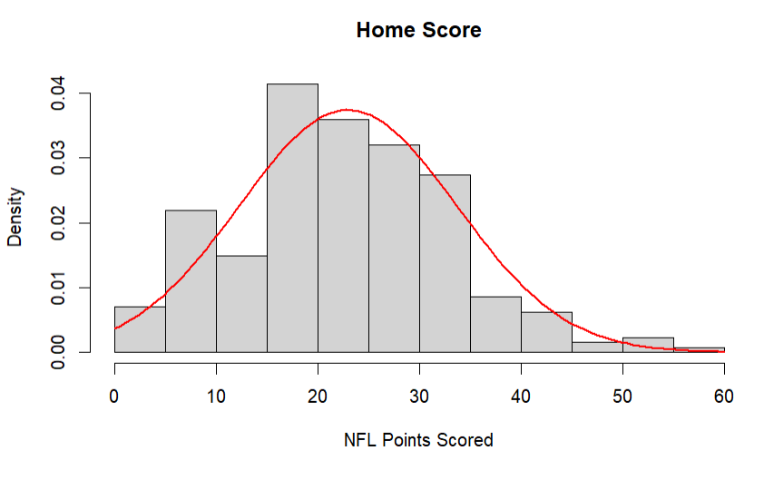
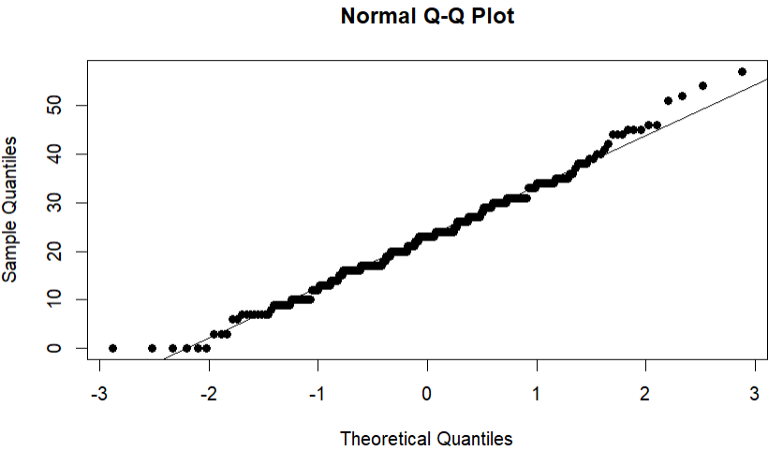
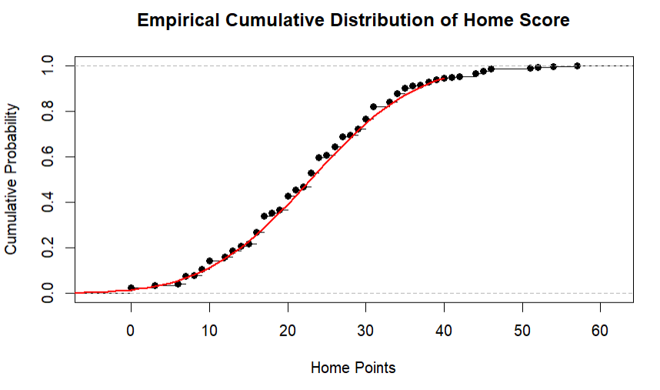
Scoring Distribution (Home Score)
Mean: 22.96
Standard Deviation: 10.67
Shapiro-Wilkes Test p-value: 0.98921

Slide 6
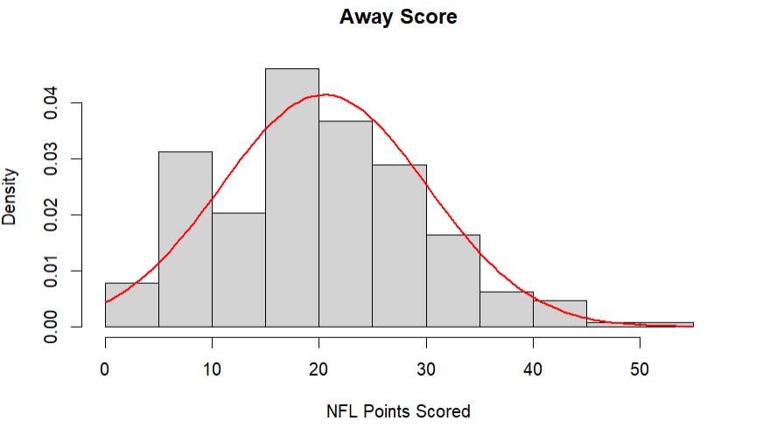
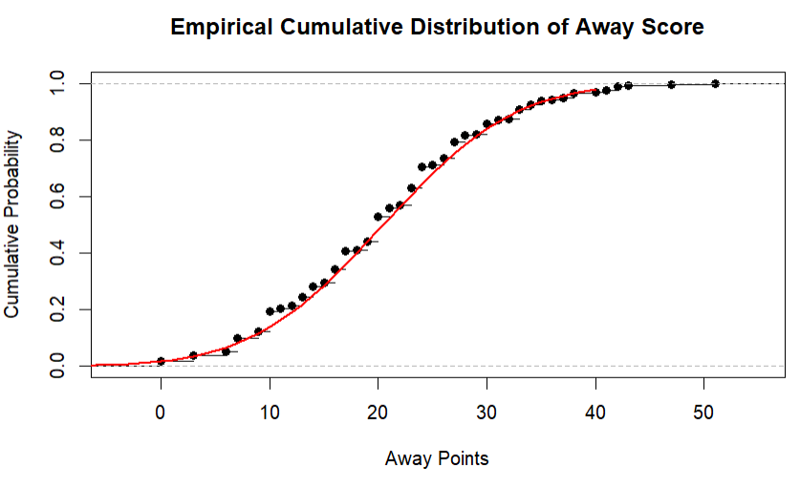
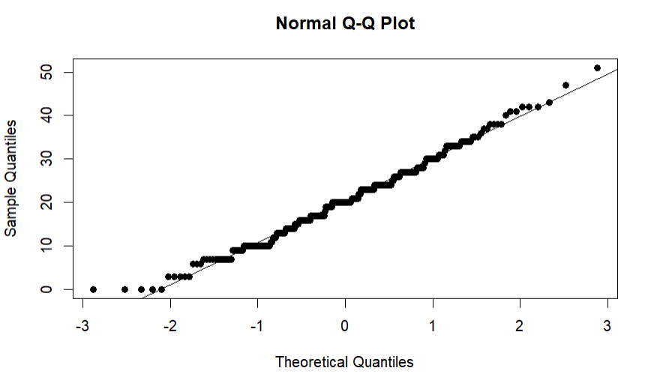
Scoring Distribution (Away Score)
Mean: 20.48
Standard Deviation: 9.64
Shapiro-Wilkes Test p-value: 0.2524613

Slide 7
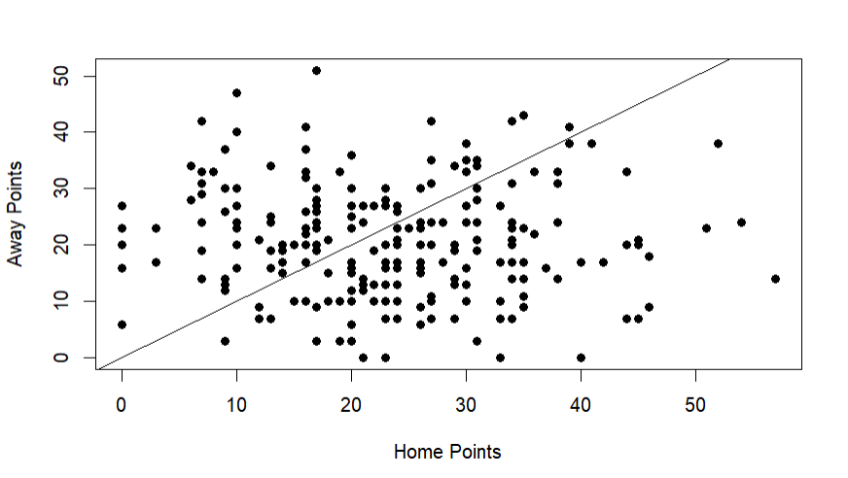
Scoreline Distribution (Home vs. Away)

Slide 8
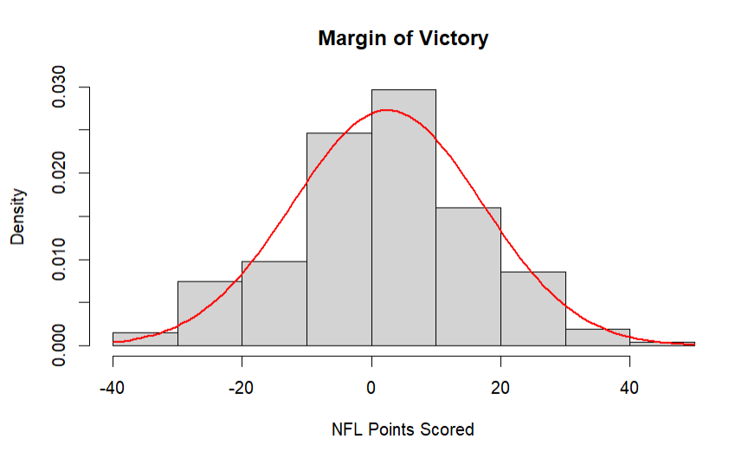
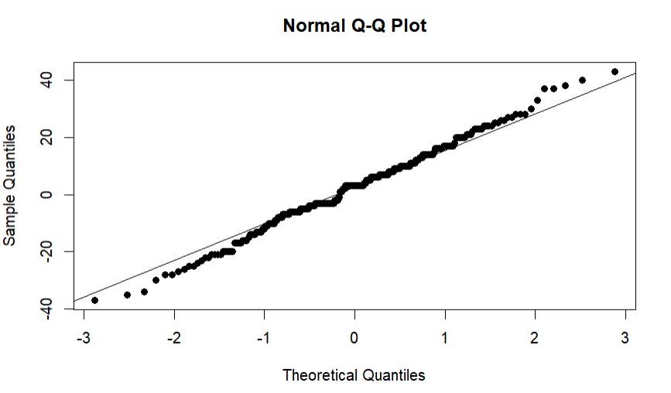
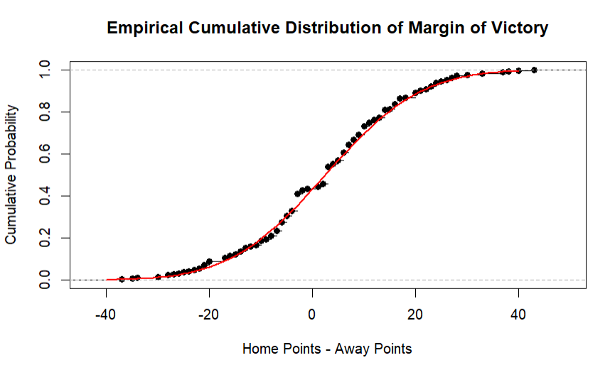
Scoring Distribution (Margin of Victory)
Mean: 2.48
Standard Deviation: 14.62
Shapiro-Wilkes Test p-value: 0.5503

Slide 9
Scoring Distribution Discussion
Home Points | Away Points | Home vs. Away | MoV
There is an approximately normal distribution of home points scored according to the normal probability plot, however, the histogram seems a little skewed right. On average, the home team scores 22 points, however there are some outliers in which the home team scores upwards of 50 points. It is interesting that the 5–10-point bin of the histogram is almost as great as the center of the histogram, meaning there are just as many home teams scoring 5-10 points as there are scoring 20-25 points. I would account that as being a difference in team strength; some home teams win through their defense (5-10 points) and some their offense (20-25 points). | The away team points histogram looks extremely like the home team points histogram. The average away team points is 20, however, like the home team distribution, we see some outliers up towards the 50-point bin. The away points distribution is approximately normal, but arguably skewed right. We see the same anomaly in the 5—10-point bin that we saw in the home point histogram, thus more evidence that this is caused by variety in team strength (offense vs. defense). This could also be because not every team truly gets a home field advantage. The Rams are known to not play differently at home vs. away. Some teams, like KC play exceptionally better at home which could cause these differences in the histogram. | The scatterplot between home points and away points does not show any real relationship between the two variables. There is no pattern that can be seen; thus, we can conclude that neither variable will indicate any information about the other. The number of points the home team scores has no influence on the number of points the away team scores and vice versa. Logically, this makes sense, since one team’s offense is independent of their defense. A team may be great at scoring points, but their defense could be bad at stopping points. Thus, no information can be determined by using solely home and away points. | The margin of victory histogram had an approximately normal distribution with no skewing or other anomalies. On average, the margin of victory is between 2 and 3 points, which means the average home team would beat the average away team by 2.5 points. This makes sense because you would expect the team with the home team advantage to win the game, however, I would have expected the margin of victory to be between 3 and 6 since those are the points allotted to a field goal and a touchdown. Having a margin of victory less than 3 suggests that there are a games in which the away teams win that are pulling the average down below 3, thus we can conclude it isn’t unlikely the away team wins what with the similar point distribution and small margin of victory average.

Slide 10
Pythagorean Win Percentages
 | wpct | pyth |  | wpct | pyth |  | wpct | pyth |  | wpct | pyth
BUF | 0.5625 | 0.3879970 | BAL | 0.5625 | 0.6679491 | HOU | 0.2500 | 0.3382512 | DEN | 0.3125 | 0.3240093
MIA | 0.3750 | 0.2923011 | CIN | 0.4375 | 0.3803295 | IND | 0.2500 | 0.2438844 | KC | 0.6250 | 0.6302270
NE | 0.8125 | 0.7596218 | CLE | 0 | 0.1856810 | JAX | 0.6250 | 0.7623018 | LAC | 0.5625 | 0.6686285
NYJ | 0.3125 | 0.3419600 | PIT | 0.8125 | 0.6744065 | TEN | 0.5625 | 0.4580625 | LV | 0.3750 | 0.3623169
DAL | 0.5625 | 0.5421810 | CHI | 0.3125 | 0.3758787 | ATL | 0.6250 | 0.5744963 | ARZ | 0.5000 | 0.3700038
NYG | 0.1875 | 0.2312756 | DET | 0.5625 | 0.5568005 | CAR | 0.6875 | 0.5683943 | LAR | 0.6875 | 0.7280315
PHI | 0.8125 | 0.7601981 | GB | 0.4375 | 0.3821137 | NO | 0.6875 | 0.6980333 | SF | 0.3750 | 0.4050118
WAS | 0.4375 | 0.4175985 | MIN | 0.8125 | 0.7496080 | TB | 0.3125 | 0.4143355 | SEA | 0.5625 | 0.5638983
*Correlation between win percentage and Pythagorean win percentage = 0.903

Slide 11
Pythagorean Win Percentages Discussion
According to the Pythagorean win percentage data, there is a very strong, positive correlation between actual win percentage and Pythagorean win percentage (r = 0.909). This suggests that in general, the Pythagorean win percentages did a very good job at predicting a team’s actual win percentage in 2017. The team with the highest Pythagorean win percentage, or the team that was predicted to win the most games out of 17, was the Jacksonville Jaguars at about 0.72, closely trailed by the Philadelphia Eagles at 0.70. The team that was predicted to win the least games was the Cleveland Browns who had a Pythagorean win percentage of 0.18. The Buffalo Bills were the most overachieving team with an actual win percentage 0.17 greater than their Pythagorean win percentage. The Cleveland Browns were the most underachieving team with an actual win percentage 0.18 less than their Pythagorean win percentage. This is especially interesting because the 2017 season had the Browns ending with a 0.0 actual win percentage, thus it would have been essentially impossible to accurately predict their win percentage using Pythagorean win percentages.

Slide 12
Bradley-Terry Ratings
Buffalo | -4.04 | Baltimore | 3.28 | Houston | -6.40 | Denver | -6.69
Miami | -6.14 | Cincinnati | -4.98 | Indianapolis | -10.01 | Kansas City | 3.46
New England | 8.75 | Cleveland | -10.82 | Jacksonville | 6.71 | Los Angeles (Chargers) | 3.70
New York (Jets) | -4.93 | Pittsburgh | 5.02 | Tennessee | -3.45 | Las Vegas | -4.56
Dallas | 1.62 | Chicago | -1.35 | Atlanta | 4.20 | Arizona | -3.83
New York (Giants) | -7.54 | Detroit | 2.65 | Carolina | 4.26 | Los Angeles (Rams) | 9.30
Philadelphia | 9.43 | Green Bay | -1.96 | New Orleans | 8.99 | San Francisco | -2.83
Washington | -1.29 | Minnesota | 8.93 | Tampa Bay | -1.35 | Seattle | 1.91

Slide 13
Bradley-Terry Ratings Discussion
According to the adjusted Bradley-Terry Ratings, Philadelphia was the best team with a rating of 9.43, whereas Cleveland was the worst team with a rating of -10.82. The teams that were closest to average were those with ratings nearest 0, these included: Dallas (1.62), Washington (-1.29), Chicago (-1.35), Tampa Bay (-1.35), Green Bay (-1.96), and Seattle (1.91). Interestingly, it seems the most average teams in the league were a part of the NFC, whereas the more extraneous ratings belonged to teams in the AFC. It is important to note that the Bradley-Terry ratings consider score differential when creating the ratings. This becomes interesting when we look at the comparison of teams that had the same season record but relatively different ratings. For instance, New Orleans and Carolina each ended with 11 wins, but New Orleans had a rating doubling that of Carolina. This occurred because New Orleans had major blowout wins against Buffalo and Detroit that pulls up their rating. This accounts for the Bradley-Terry rating disparity despite the same record.

Slide 14
Preseason and Postseason Elo Ratings
 | Pre | Post |  | Pre | Post |  | Pre | Post |  | Pre | Post
BUF | 1482.104 | 1510.042 | BAL | 1486.818 | 1543.035 | HOU | 1497.578 | 1349.402 | DEN | 1558.287 | 1426.449
MIA | 1500.933 | 1418.777 | CIN | 1514.262 | 1456.890 | IND | 1505.644 | 1355.889 | KC | 1608.883 | 1619.785
NE | 1685.287 | 1743.425 | CLE | 1330.897 | 1193.295 | JAX | 1372.460 | 1502.994 | LAC | 1431.043 | 1550.042
NYJ | 1448.347 | 1392.064 | PIT | 1594.790 | 1666.269 | TEN | 1448.986 | 1479.288 | LV | 1522.824 | 1443.549
DAL | 1563.653 | 1566.524 | CHI | 1378.390 | 1392.334 | ATL | 1605.208 | 1632.432 | ARZ | 1535.481 | 1472.083
NYG | 1521.600 | 1362.569 | DET | 1494.785 | 1526.671 | CAR | 1524.642 | 1580.406 | LAR | 1395.816 | 1559.614
PHI | 1503.130 | 1641.274 | GB | 1579.474 | 1461.442 | NO | 1489.372 | 1613.855 | SF | 1354.440 | 1423.115
WAS | 1499.590 | 1454.097 | MIN | 1500.106 | 1657.981 | TB | 1491.929 | 1438.551 | SEA | 1573.166 | 1565.782

Slide 15
Elo Ratings Discussion
At the beginning of the 2017 season, the Elo ratings suggested that Cleveland was the worst team in the league with a 1330.897 rating, while New England was the best team with a 1685.287. This makes sense because New England is still in their Tom Brady dynasty, winning many consecutive games. At the end of the season, these two teams still were respectively the worst and best teams in the league, however, Cleveland’s Elo dropped to 1193.295 whereas New England’s Elo jumped to 1743.425. The team with the biggest drop in Elo was the New York Giants, dropping about 160 points, whereas the Los Angeles Rams had the biggest gain across the season, gaining 164 points. Over the course of the season, two teams had a net change in Elo less than 10: Dallas gained 3 points and Seattle lost about 7 points. This suggests that these two teams were the most stagnant team as far as performance goes across the 2017 season, whereas the Los Angeles Rams were the most improving team, and the New York Giants were the most declining team.

Slide 16
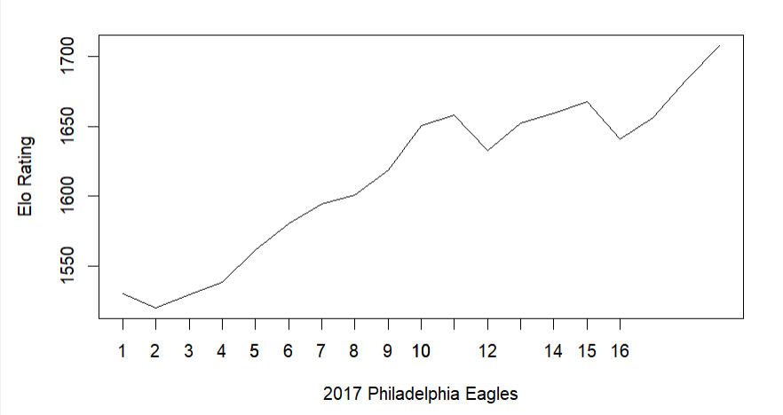
Eagles Elo Ratings Across the Season

Slide 17
Eagles Elo Ratings Discussion
The Eagles were the Superbowl winners of 2017, and despite having some setbacks in the postseason, their record of 13-4 in the regular season as well as their Elo ratings graph shows that they were the deserved winner. They started the season with an Elo of 1503 and ended the regular season with a rating of 1641. Besides a loss in week 2, the Eagles Elo rapidly increased to 1650 by week 12. A rather big loss in week 11 accounts for a noticeable dip in Elo, however, there is a not as drastic yet steady increase in rating up to 1675 for the next 3 weeks until week 17 where a loss sets them back down to their ending Elo. This loss may not even be characteristic of the true Eagles team at this point, for it was the last game of the regular season and by this point, the Eagles already were the confirmed NFC one seed, so they played their second and third-string players to keep their starters healthy. If their starters played, this last game may have been a win for the Eagles, making their postseason Elo even higher than what is recorded. Overall, the Eagles performed extremely well with no dry spells and a 9-game win streak, improving with each game across the season.
*It is also interesting that despite losing their star starting quarterback with 3 games left in the regular season, their backup was able to win 2 out of the 3 (the third being the throwaway game to rest their starters) and still drive the team through the playoffs to a Superbowl victory. You would expect a team-altering injury would result in a decrease in Elo in the remaining season time, but the Eagles were still able to prevail and increase their Elo.

Slide 18
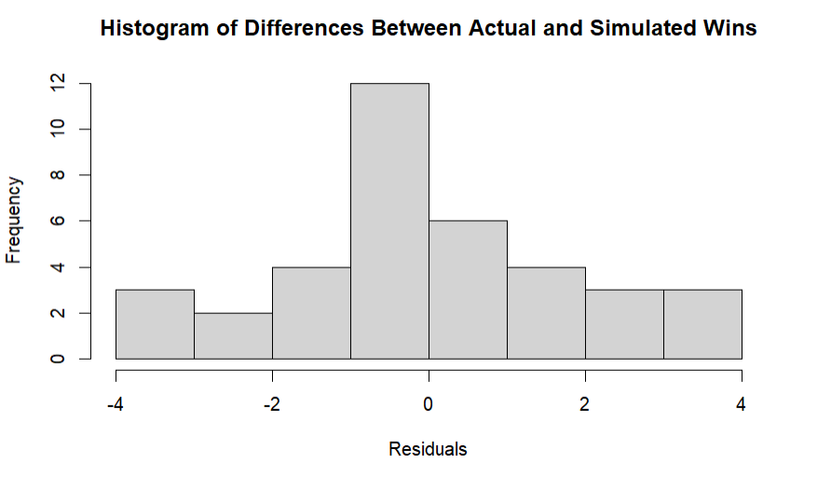
Monte Carlo Simulation
 | Actual Wins | Sim. Wins | Div. Titles |  | Actual Wins | Sim. Wins | Div. Titles |  | Actual Wins | Sim. Wins | Div. Titles |  | Actual Wins | Sim. Wins | Div. Titles
BUF | 9 | 7.4808 | 0.0445 | BAL | 9 | 8.9605 | 0.2005 | HOU | 4 | 7.3280 | 0.1800 | DEN | 5 | 7.9452 | 0.1191
MIA | 6 | 6.9463 | 0.0260 | CIN | 7 | 7.5523 | 0.0711 | IND | 4 | 6.9929 | 0.1413 | KC | 10 | 10.8577 | 0.7538
NE | 13 | 12.0082 | 0.9173 | CLE | 0 | 3.3006 | 0.0003 | JAX | 10 | 8.3607 | 0.3713 | LAC | 9 | 6.9375 | 0.0519
NYJ | 5 | 6.2422 | 0.0122 | PIT | 13 | 10.9775 | 0.7281 | TEN | 9 | 8.0490 | 0.3074 | LV | 6 | 7.4167 | 0.0752
DAL | 9 | 8.8120 | 0.2827 | CHI | 5 | 5.2911 | 0.0135 | ATL | 10 | 9.4770 | 0.4090 | ARZ | 8 | 8.1508 | 0.2187
NYG | 3 | 6.2983 | 0.0396 | DET | 9 | 8.5727 | 0.2490 | CAR | 11 | 8.7887 | 0.2552 | LAR | 11 | 7.7971 | 0.1689
PHI | 13 | 9.9556 | 0.5627 | GB | 7 | 8.9100 | 0.3162 | NO | 11 | 9.0157 | 0.2956 | SF | 6 | 4.2781 | 0.0043
WAS | 7 | 7.5377 | 0.1150 | MIN | 13 | 9.4403 | 0.4213 | TB | 5 | 6.4308 | 0.0402 | SEA | 9 | 9.8880 | 0.6081

Slide 19
Comparison of Simulation and Actual Regular Season
Overall, the Monte Carlo simulation did a relatively good job at predicting actual wins for each team in the 2017 season. The greatest residual between actual and simulated win totals was either overpredicted or underpredicted by 3 games. In a season with 17 games and 32 teams, missing 3 games for 8 teams is not a poor showing. The teams that were overpredicted by 3 games included: Houston Texans, Cleveland Browns, New York Giants, Indianapolis Colts, and the Denver Broncos. The teams that were underpredicted by 3 games included: Minnesota Vikings, Los Angeles Rams, and the Philadelphia Eagles. There were an additional 7 teams that had a simulated win total that was within one game of their actual win total. These teams included: Miami Dolphins, Kansas City Chiefs, Seattle Seahawks, Cincinnati Bengals, Washington Commanders, Arizona Cardinals, and the Chicago Bears.
The simulation only failed to predict two division winners: the NFC South and the NFC West. For the NFC South, the simulation predicted the Atlanta Falcons to win the division, however the New Orleans Saints were the winners. To give some credit to the simulation, three teams in the NFC South were within 1 game of each other and the simulated proportions for division winners were relatively equal across those 3 teams. To elaborate, the simulation was very close to predicting the correct division winner in a division whose winner is always a coin toss, so it’s not as if the simulation was drastically off. For the NFC West, the simulation predicted the Seattle Seahawks to win the division, however the Los Angeles Rams were the winners. Seattle ended 2 games under LA. The disparity between the simulation and reality can be explained in that Seattle lost 6 of their 10 close games, whereas LA won 4 of their 7 close games. The fact that the two won the same number of close games yet Seattle had 3 more opportunities to take the lead could be reason as to why the Seahawks underperformed relative to the simulation.

Slide 20
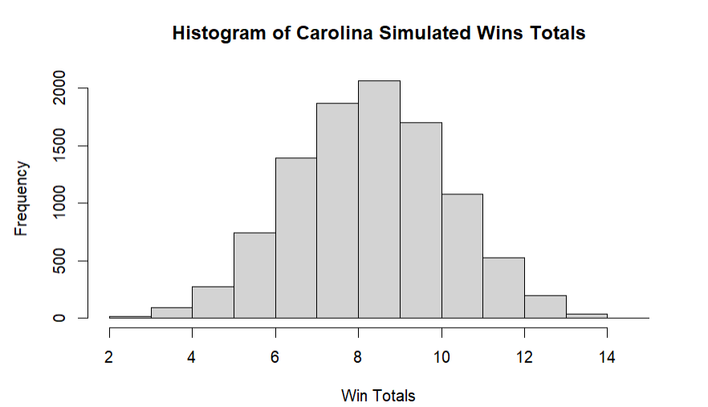
Analysis of Overachieving Team:
Carolina Panthers
The Carolina Panthers were one of the most overachieving teams according to the Monte Carlo Simulation. They were expected to win between 8 and 9 games, but actually won 11. This can be attributed to the Pythagorean win percentage data where we see that the Panthers won 8 of their 9 close games, despite their quarterback having a QBR rating that sits at the center of the QBR histogram.

Slide 21
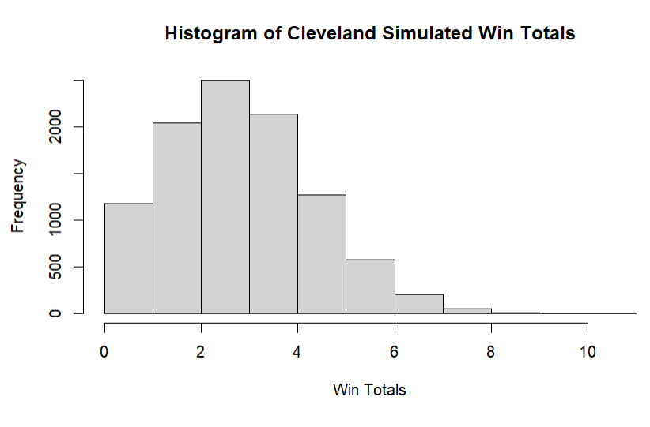
Analysis of Underachieving Team:
Cleveland Browns
The Cleveland Browns were one of the most underachieving teams in 2017. The Monte Carlo simulation predicted them to win about 3 games, however, they never won in the 2017 season. This makes sense because their quarterback had a QBR rating that sat at the lowest bin of the QBR rating histogram. Also, according to their calculated Pythagorean win percentages, the Browns won 0 out of their 6 close games. This serves as more explanation as to why they performed so poorly in 2017.

Slide 22
Conclusions/Takeaways
The Monte Carlo simulation gave a very accurate prediction of what each team’s actual wins would look like in the 2017 season.
It did an even better job at predicting the division winners, only failing 2 out of 8 divisions.
  One of those divisions had a tie for division winner that was determined by head-to-head wins.
The most overachieving team in the simulation was Minnesota and the most underachieving team in the simulation was Houston
The Bradley-Terry ratings had Philadelphia as the best team and Cleveland as the worst team
The postseason Elo ratings had New England as the best team and Cleveland (still) being the worst team.

